Slide 1


Final Presentation
Courier Management Project
Eva Poluliakhov
Katya Stekolchick
11/09/25

Slide 2
Project Goals
Parallel and distributed real-time delivery assignment and tracking.
Role-based dashboards: Business, Courier, Admin.
User-friendly and energy-efficient system.

Slide 3
Logical Architecture
Firebase Authentication
Google Maps API
React Frontend
Firebase Firestore (database)
REST API
Client Browser
Authentication
Middleware
GIN handler
Go Backend (User & Delivery services)

Slide 4
Main
Modules
Design
Auth-Context
Auth-Context
Map Loader
App
Router
Invalid Route
Protected Route
Login/Sign In
Role Selection
Courier
Admin
Business
Courier
FireStore Snapshots
API Calls
Get
Post
Patch
FireStore (DB)
Delivery Service
Get Deliveries
Create Delivery
Update Delivery
User Service
Get me Get Users (Admin)

Slide 5
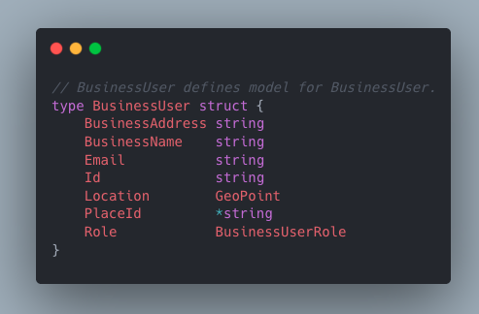
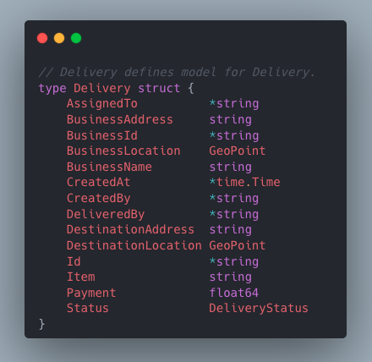
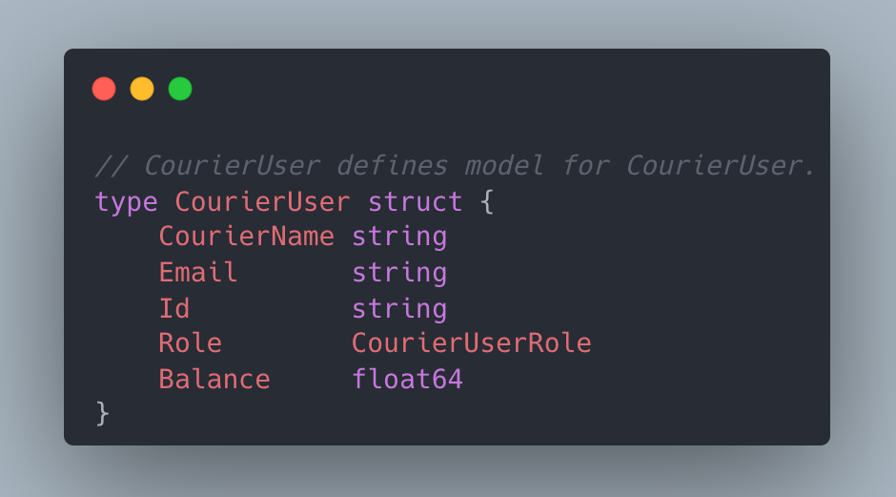
Objects Structure

Slide 6
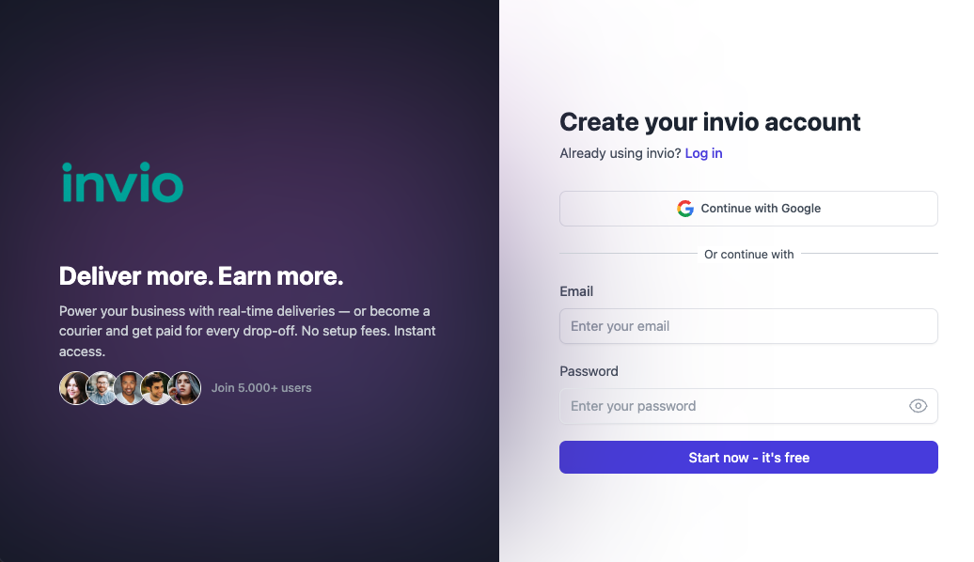
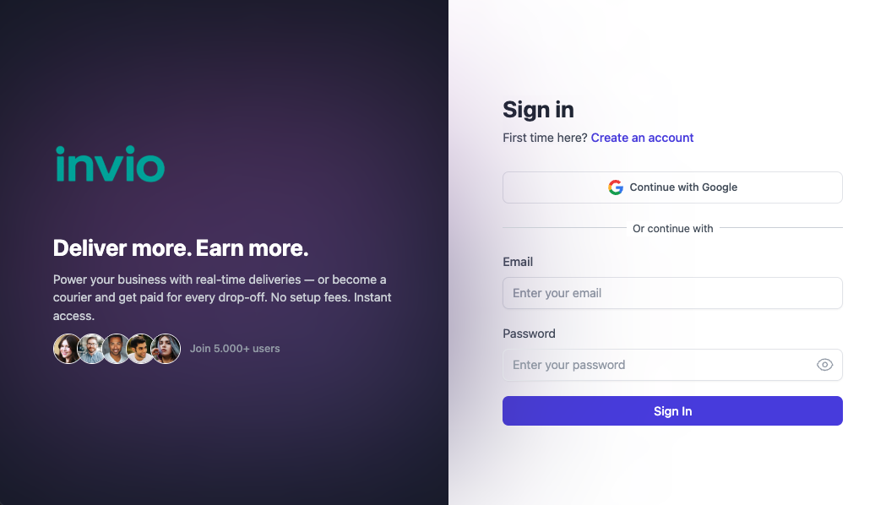
Login
SignUp

Slide 7
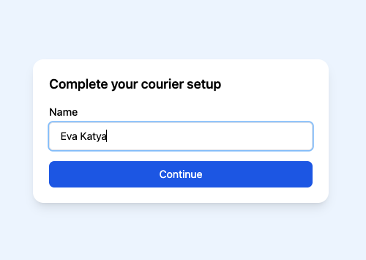
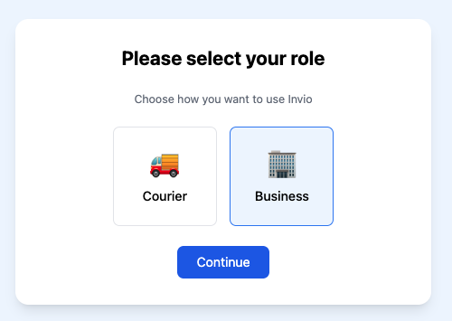
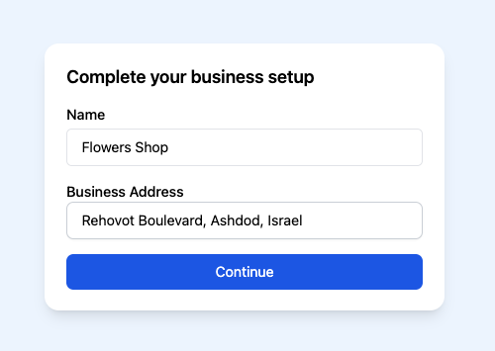
New User: Role Selection Flow
Courier
Role based UI
Business

Slide 8
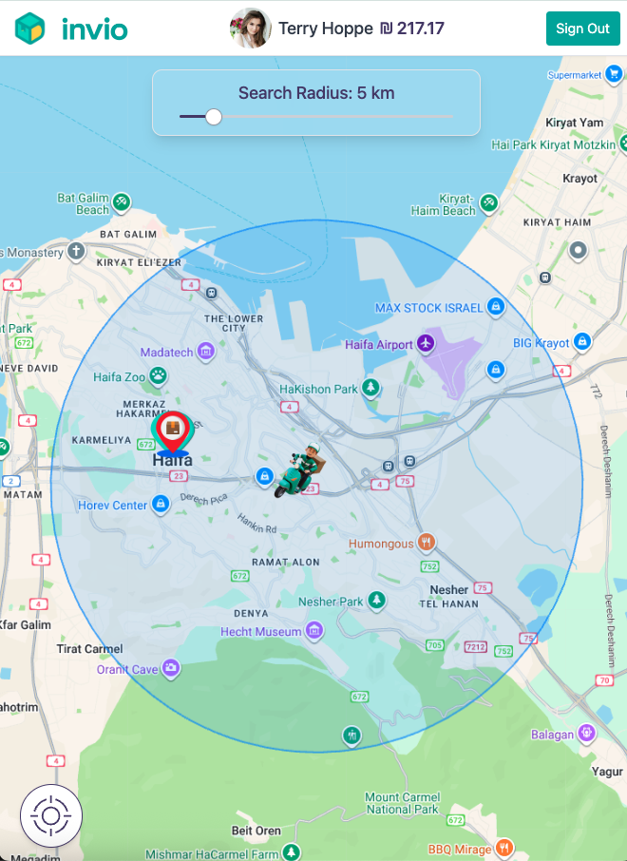
Courier
initial view

Slide 9
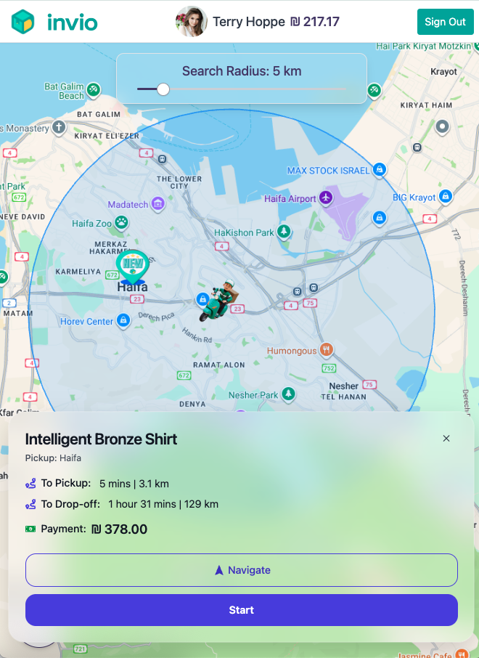
Courier
delivery card

Slide 10
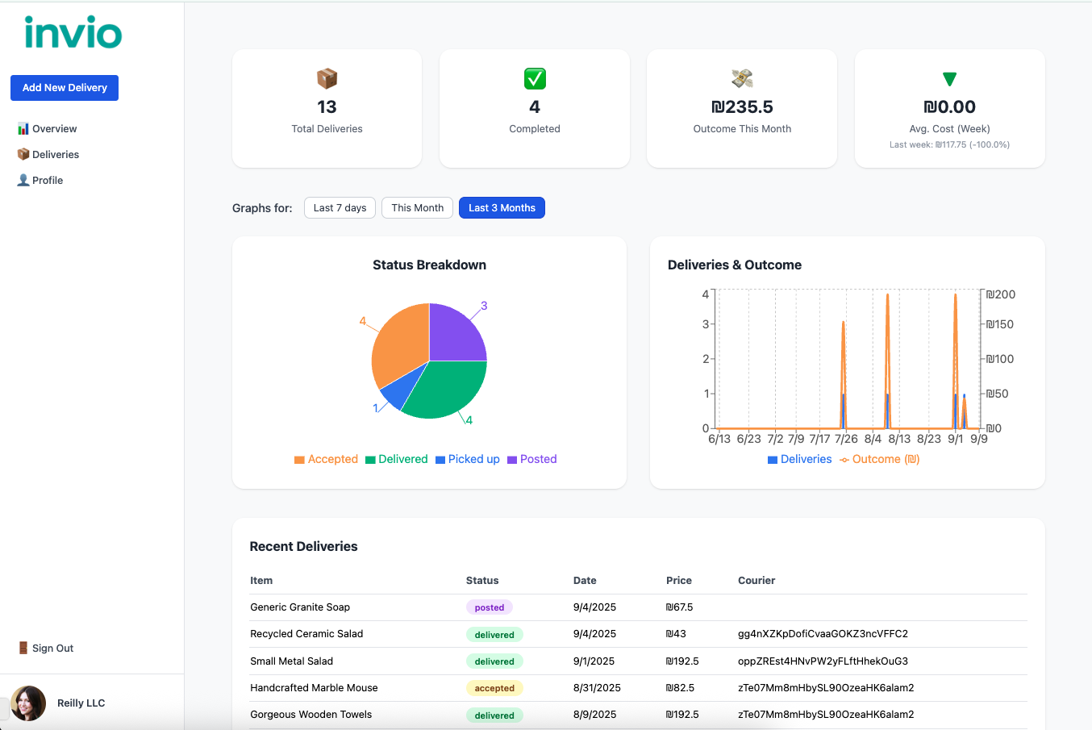
Business
initial view

Slide 11
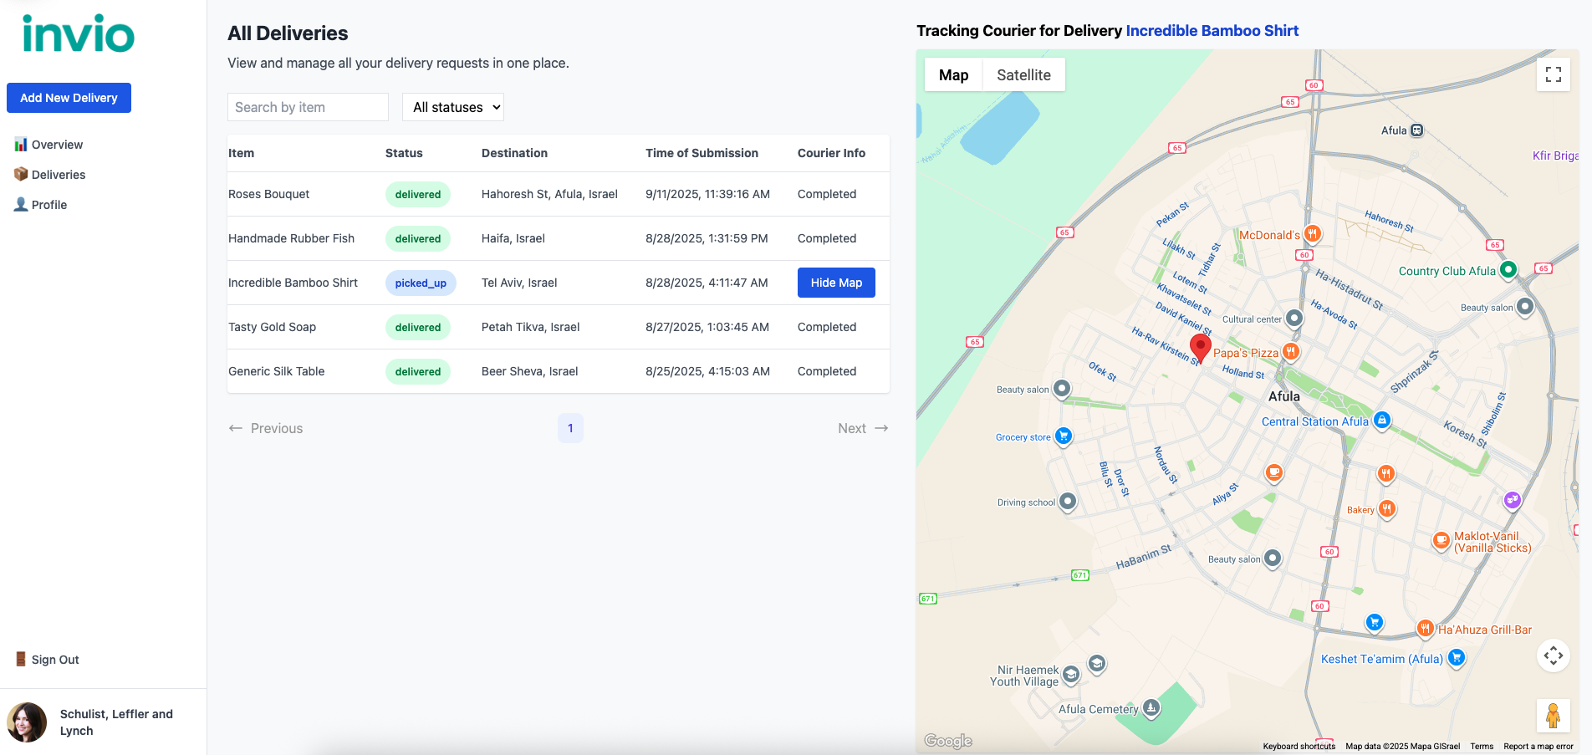
Business
deliveires tab

Slide 12
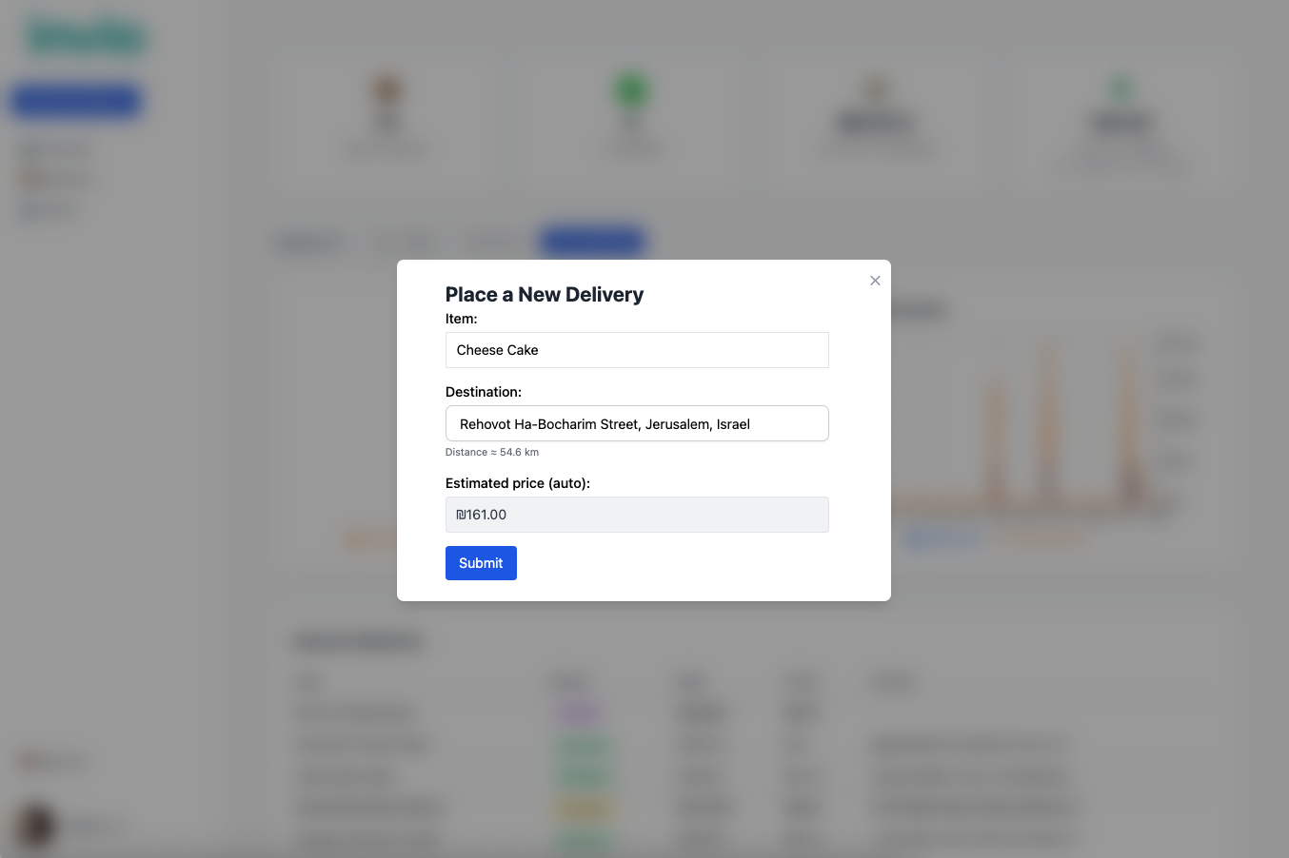
Business
new delivery

Slide 13
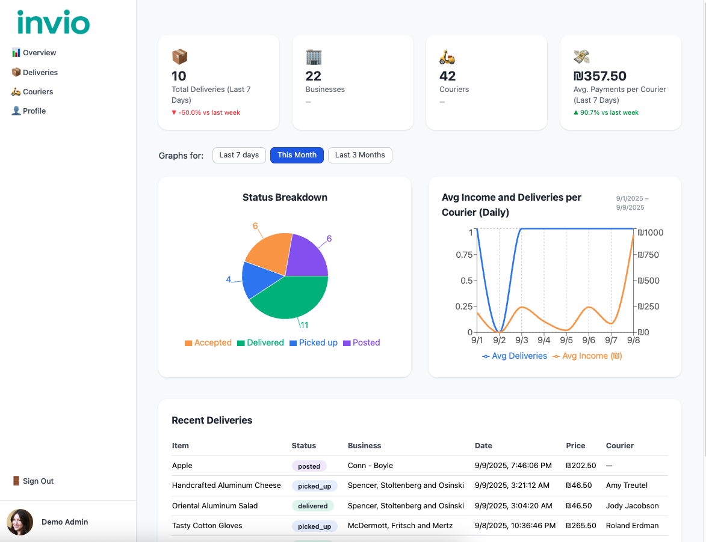
Admin
initial view

Slide 14
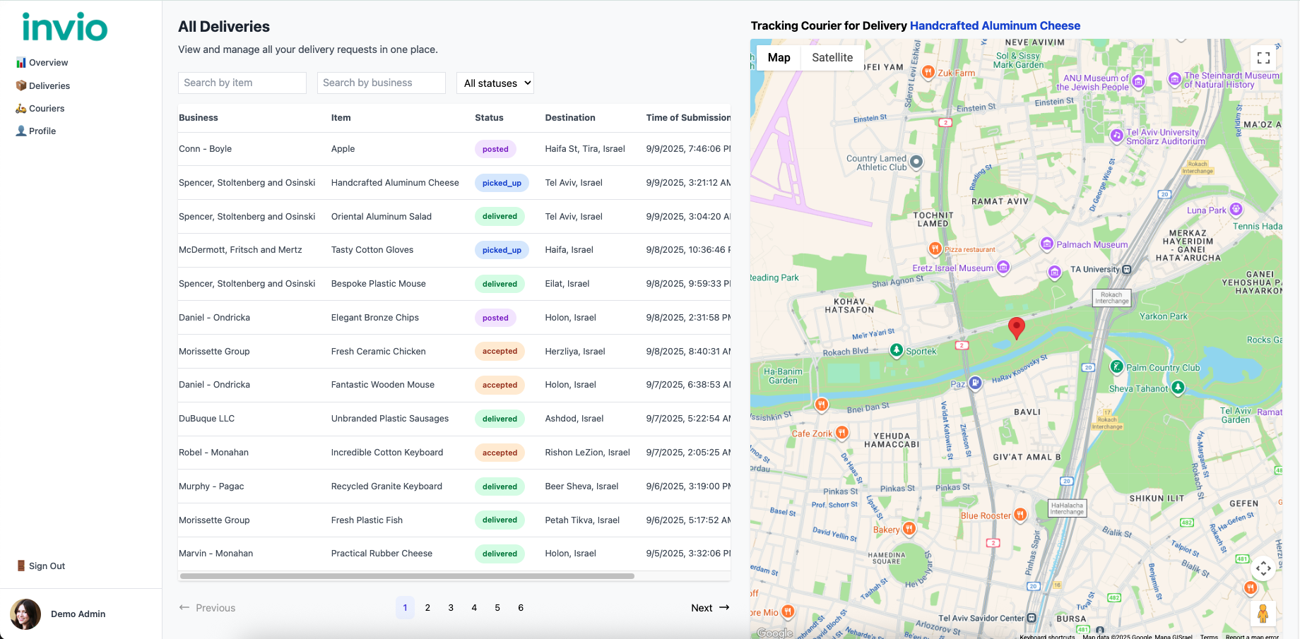
Admin
deliveries tab

Slide 15
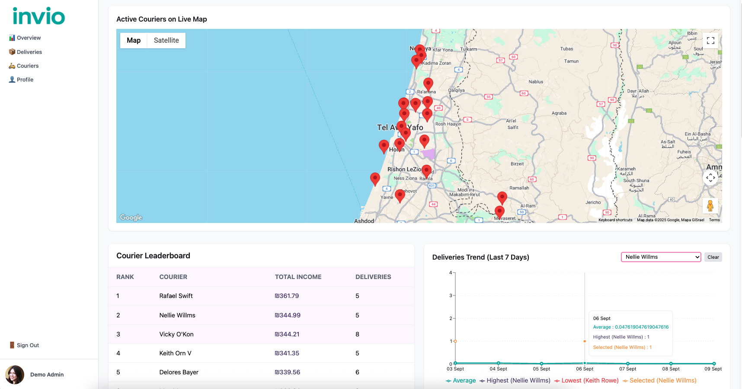
Admin
couriers tab

Slide 16
Live Demo
log in -> sign in -> business role selection
Business: tabs -> new delivery
Courier: accept (biz can’t see on map)-> pickup (biz sees on map) -> delivered (biz can’t see) -> payment updated. (remember to close tab and navigate again) (upon accept) two couriers trying to accept the same delivery
Admin: tabs
business :afula.biz20@example.com
admin: eva.poluliakhov@nitzanim.tech
courier1: rafael_swift@example.com
courier2: jody_kuhlman@example.com

Slide 17
What Went Well ?
Successful teamwork and the achievement of all professional goals.
Firebase was an outstanding choice, it simplified authentication and user management.
External UI libraries helped with fast and modern design integration.
Use of OpenAPI for API design, ensured a well structured code, capturing all fields and reduced frontend-backend communication problems.
PostMan simplified complex manual testing.
Real time tracking and updating is smooth and almost instant.
Application is simple, user friendly and modularized code by user type.

Slide 18
Main Difficulties
Building a fullstack project from scratch.
Learning languages, technologies, professional standards, and work methodologies on the go.
We had to decide how to structure the data and how it communicates (GIN infra., handlers implementation, DB access)
Google Maps integration (Proper loading, test simulation, UI)
API requests VS. onSnapshot response time
Understanding the main difference between user authentication and user request authentication

Slide 19
Potential Extensions
Deployment and broadcasting the application.
FCM push notifications (suggestions for deliveries on the way).
Functionality for withdrawing funds and issuing payslips.
Chat support between the business and the courier.
Expanding admins capabilities.
Adding advertising to expand the business model.
AI integrating: smart adjustment of deliveries based on past data for a courier defining work hours and a financial goal for that day.
UI polish.
Navigation animation.

Slide 20
Use of Generative AI Tools
ChatGPT helped us understand the advantages and disadvantages of the tools and languages ​​available to us in development, choosing them, and finally learning how to use them.
Based on the professional and detailed files we wrote, uploaded to chatGPT, we created yaml and the openAPI codegen from it, which was very helpful in creating the structure of the backend and REST API and paying attention to all the little details.
Codereview, troubleshooting and suggesting fast solutions (distance, payment, loader logic)
Implementing part the app design based on our detailed vision.
AI provided a speed boost and a creative view, but the core system design and critical sections were coded and verified by us to meet the project’s specific requirements.

Slide 21
Conclusion
The Courier Management System project demonstrates a successful combination of progressive web technologies, cloud services, real-time features and generative AI.
We have created a good and stable infrastructure for future expansion and improvement.
The challenges faced were educational and led to a deeper understanding of full-stack development, especially in handling real-time collaborative data.

Slide 22

Thank you!

